Slide 1

SSTA
Monday 14th September 2021
Ken Muir
Independent Advisor to the Scottish Government on the Reform of the SQA and Education Scotland
https://www.gov.scot/policies/schools/education-reform/
EducationReform@gov.scot

Slide 2
My remit
….provide advice to the Scottish Government and the Cabinet Secretary for Education and Skills on aspects of education reform. This will include designing the implementation of the OECD’s recommendations for structural and functional change of SQA and Education Scotland. It will include the delivery of the national curriculum, assessment, qualification and inspection functions, and recognise and include the wider functions of both these bodies.

Slide 3
Expert Panel
This group of individuals have been selected by me to support me on the delivery on my remit. The individuals have both a broad understanding of education and/or change management/organisational design and specific expertise in areas that I consider will be useful to me in progressing my work.

Slide 4
Practitioner and Stakeholder Advisory Group
This large group comprises individuals representing almost 50 organisations who are most likely to be affected to some degree by the reform programme. As such, they are most likely to have views and ideas on what reform might look like as well as the practical considerations and implications of any proposed changes.

Slide 5
Practitioner and Stakeholder Advisory Group
      The purpose of the Advisory Group is to provide feedback, input and advice on the work of the Advisor to support the production of his Report in respect of the next steps to implement the OECD’s recommendations for structural and functional change of SQA and Education Scotland.
      They [PSAG members] will engage with members of the Expert Panel as the reform work progresses and it is expected that its members will communicate and engage with their own organisations and wider networks to seek their views and suggestions which they will feed back to the Advisor.

Slide 6
Practitioner and Stakeholder Advisory Sub-Groups
      Professional Associations
      Staff unions @ SQA and ES
      Early years and childcare
      Children and young people
      Parental bodies
      Post-school sectors
      National bodies

Slide 7
Timescale
August 2021 to January 2022 (6 months)
Report to Cab Secy - early 2022
Expert Panel meetings – end August + early Sept.
Practitioner+Stakeholder Advisory Group (PSAG) – mid-September + mid-November
Ongoing engagement and feedback from PSAG members
Early meetings with SQA + Education Scotland + other key bodies - ongoing as required
Sept/Oct – meetings with PSAG organisations
Nov - PSAG sub-group meetings
Late Nov/early December – report drafting

Slide 8
Engagement Opportunities
Meetings schedule – 90-minute slots Sept/Oct + 10 early Nov.
National Consultation – Sept/Oct/Nov (12 weeks)
Twilight webinars (16:30-18:00) – 27 and 30 September; 6th and 28th October
Attendance at Education Governance Groups – Sept to Nov
Inputs at conferences/seminars inc. SLS on 21st Sept.
Direct submissions to Education Reform email box
EducationReform@gov.scot
OECD report on Assessment by Prof. Gordon Stobart
RICs report by Research Scotland – end October

Slide 9
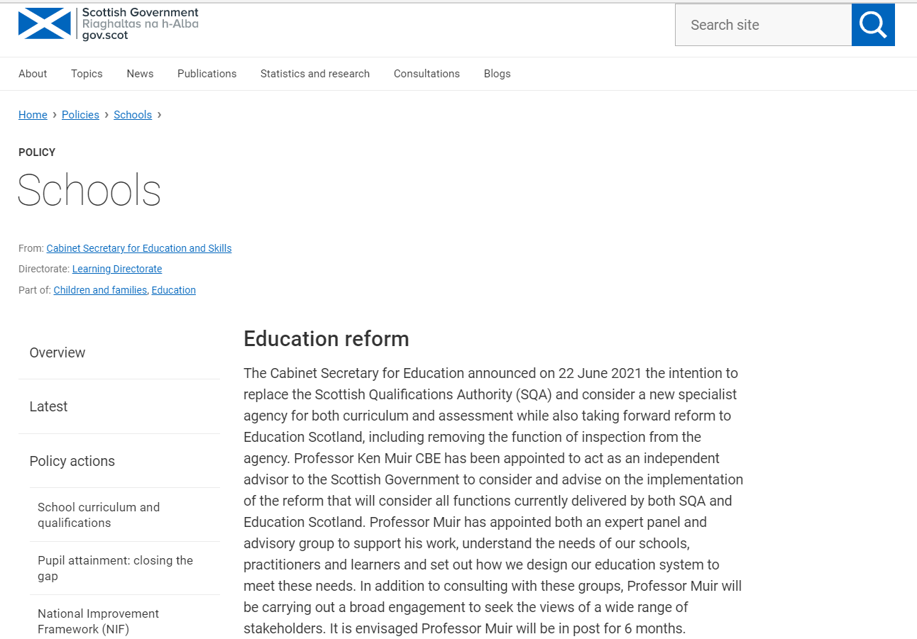
Scottish Govt. Education Reform Website
https://www.gov.scot/policies/schools/education-reform/

Slide 10
Discussion Questions
What are the strengths of Curriculum for Excellence (CfE) and what could be improved?
To what extent is there a misalignment between curriculum and assessment in the Scottish education system?
In what specific areas is there confusion, overlaps or gaps around the ownership of CfE and how it is supported?
In what ways can space be made for student voices and students’ input be taken into account in curriculum reform?
What are the opportunities and risks of replacing the Scottish Qualifications Authority with a new specialist agency for both curriculum and assessment and reforming Education Scotland, including removing the function of inspection?

Slide 11
Supplementary Questions
What vision does SSTA have for our future education system?
The OECD report points to an apparent (mis)alignment between curriculum, assessment and evaluation policies, especially at the senior phase. How do we ensure consistent understanding of the principles of CfE so that it minimises the effects on learning experiences across schools (different approaches to subject choice; different assessment approaches in BGE and senior phase; different balance of focus on knowledge and competencies)?

Slide 12
Supplementary Questions
What are the current roles and responsibilities of the RICs and Education Scotland and how does SSTA envisage them going forward?
How do we resolve the tension of allowing local flexibility in curriculum design, and the consequent inevitability of having variability in schools’ curricula, and the potential that it might increase educational inequalities?
The CfE philosophy gives wide autonomy to schools and teachers in curriculum design. Where should this autonomy lie? LA, school/HT, class teacher?
How do we improve/clarify the transparency of responsibilities and accountability mechanisms surrounding CfE?

Slide 13
Supplementary Questions
How do we clarify and simplify the relationship between the National Improvement Framework and the other strategic frameworks and major policies in Scottish education?
What do you see as the role and functions of an independent Inspectorate?
How do we address the multiple layers of governance and additional responsibilities created around CfE which, with little co-ordination, can complicate implementation processes by generating additional policy priorities and supplementary materials?
What changes are needed to the governance structure in Scottish education to realise the ambitions of CfE?

Slide 14
SSTA
Monday 14th September 2021
Ken Muir
Independent Advisor to the Scottish Government on the Reform of the SQA and Education Scotland
https://www.gov.scot/policies/schools/education-reform/
EducationReform@gov.scot

